Slide 1
Software Project Management
Subhash Paudel
MSCSKE, IOE, Pulchowk Campus
subhash@achsnepal.edu.np
Notes:
M.Sc. Computer Engineering, Computer System and Knowledge Engineering

Slide 2
Course Description
Course Code: CACS407
Year/Semester: IV/VII
Theory: 3 Hours
Practical: 2 Hours

Slide 3
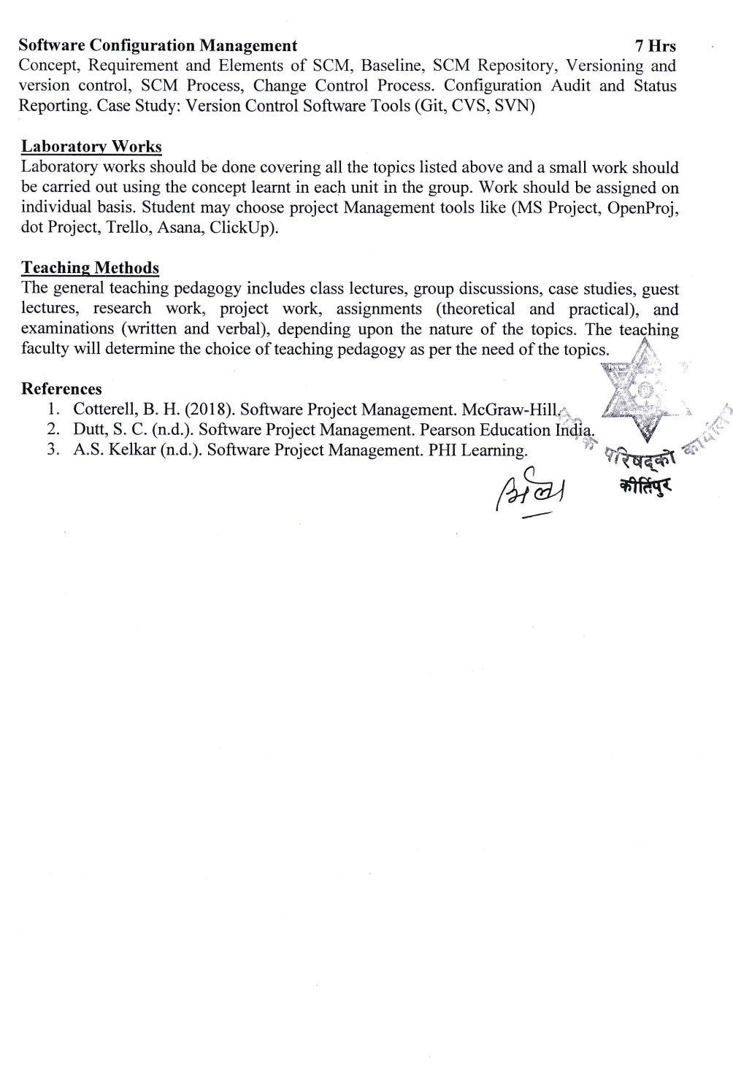
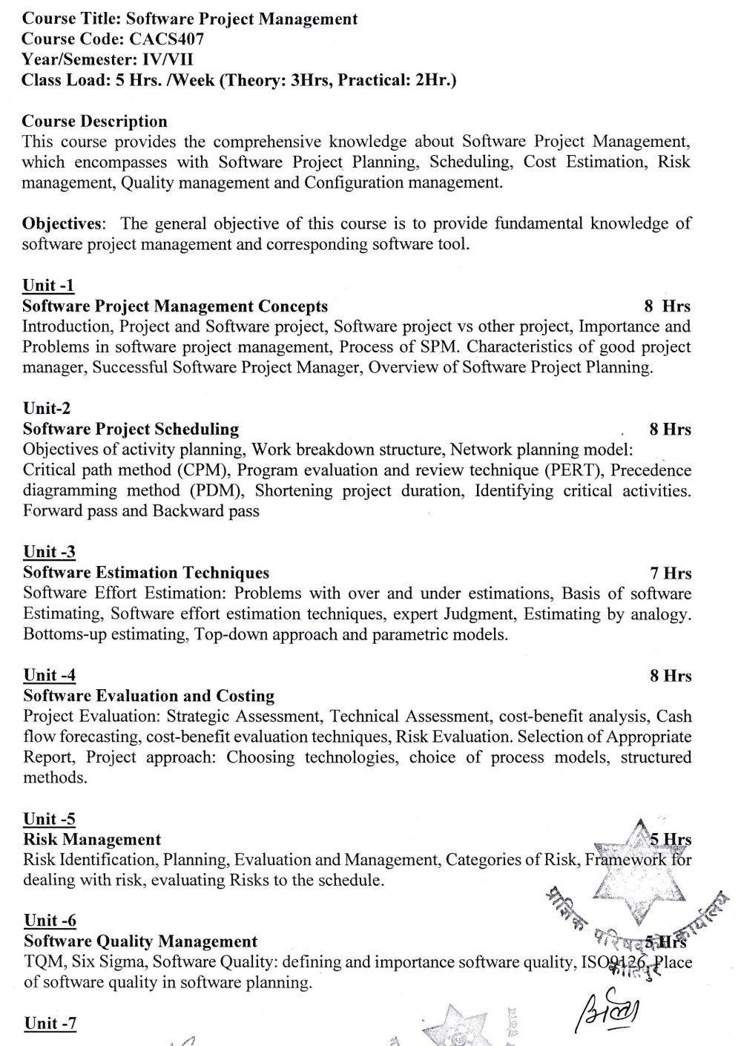

Slide 4
Program
Jobs
Business Operations
Project
Software
Software
Project Management
Management
Project Management

Slide 5
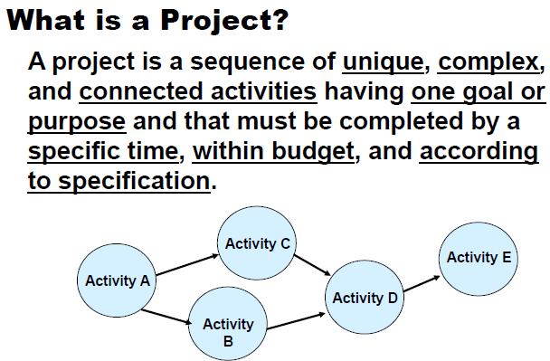
Introduction
A project is a sequence of unique, complex, and connected activities having one goal or purpose and that must be completed by a specific time, within budget, according to specification and clearly specified constraints

Slide 6
What is Project
Projects are different from business operations, in terms of uniqueness, timescale, budget, resources, risk and change.
Uniqueness: Every project is different from the last, whereas operational activities typically involve repetitive (if not identical) processes.
Timescale: A project has clearly specified start and end dates within which deliverables are produced to meet the customer’s requirements.
Budget: A project has a maximum limit to the expenditure within the deliverables must be produced, to meet the customer’s requirement.

Slide 7
What is Project
Resources: A project is allocated a specified amount of labor, equipment and materials at the start.
Risk: A project entails uncertainty and therefore carries business risk.
Change: The purpose of a project is typically to improve an organization through the implementation of business change.

Slide 8
Characteristics of Project
Non routine tasks are involved
Planning is required
Specific objectives are to be met or specified product is to be created
The project has a pre‐determined time span
Work is carried out for someone other than yourself
Work involves several specialism
Work is carried out in several phases
The resources that are available for use on the project are constrained
The project is large or complex

Slide 9
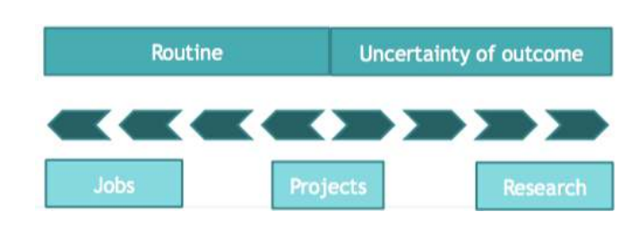
Characteristics of Project
Fig: Job Vs Project vs Research

Slide 10
PMI Definition
PMI defines Project as a temporary endeavor undertaken to create a unique product, service, or result.
Projects are undertaken to fulfill objectives by producing deliverables.
Notes:
Project Management Institute (PMI) is the leading professional association for project management, and the authority for a growing global community of millions of project professionals and individuals who use project management skills

Slide 11
Temporary endeavor
The temporary nature of projects indicates that a project has a definite beginning and end.
Temporary does not necessarily mean a project has a short duration. The end of the project is reached when one or more of the following is true:
The project’s objectives have been achieved;
The objectives will not or cannot be met;
Funding is exhausted or no longer available for allocation to the project;
The need for the project no longer exists (e.g., the customer no longer wants the project completed, a change in strategy or priority ends the project, the organizational management provides direction to end the project);
The human or physical resources are no longer available; or
The project is terminated for legal cause or convenience.
Projects are temporary, but their deliverables may exist beyond the end of the project. Projects may produce deliverables of a social, economic, material, or environmental nature. For example, a project to build a national monument will create a deliverable expected to last for centuries.

Slide 12
Fulfillment of project objectives may produce one or more of the following deliverables:
A unique product that can be either a component of another item, an enhancement or correction to an item, or a new end item in itself (e.g., the correction of a defect in an end item)
A unique service or a capability to perform a service (e.g., a business function that supports production or distribution)
A unique result, such as an outcome or document (e.g., a research project that develops knowledge that can be used to determine whether a trend exists or a new process will benefit society)
A unique combination of one or more products, services, or results (e.g., a software application, its associated documentation, and help desk services).

Slide 13
Projects are Progressively Elaborated with Repetitive elements
Repetitive elements may be present in some project deliverables and activities.
But this repetition does not change the fundamental and unique characteristics of the project work.
For example, office buildings can be constructed with the same or similar materials and by the same or different teams. However, each building project remains unique in key characteristics (e.g., location, design, environment, situation, people involved).

Slide 14
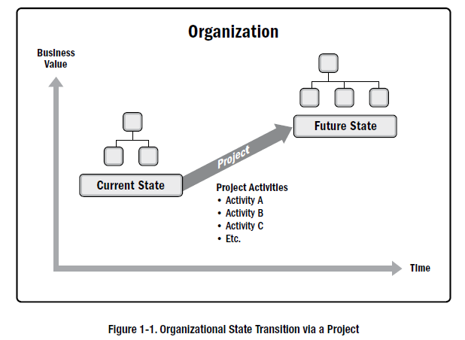
What Projects do to an organization?→Projects drive change

Slide 15
What Projects do to an organization?→Projects drive change
Projects drive change in organizations. From a business perspective, a project is aimed at moving an organization from one state to another state in order to achieve a specific objective (figure 1-1 previous slide).
Before the project begins, the organization is commonly referred to as being in the current state. The desired result of the change driven by the project is described as the future state.
For some projects, this may involve creating a transition state where multiple steps are made along a continuum to achieve the future state.
The successful completion of a project results in the organization moving to the future state and achieving the specific objective.

Slide 16
Projects enable business value creation
Business value in projects refers to the benefit that the results of a specific project provide to its stakeholders. The benefit from projects may be tangible, intangible, or both.
Examples of tangible elements include:
1. Monetary assets, 2. Stockholder equity, 3. Market share.
Examples of intangible elements include:
Goodwill,
Brand recognition,
Public benefit,
Trademarks,
Strategic alignment, and
Reputation.

Slide 17
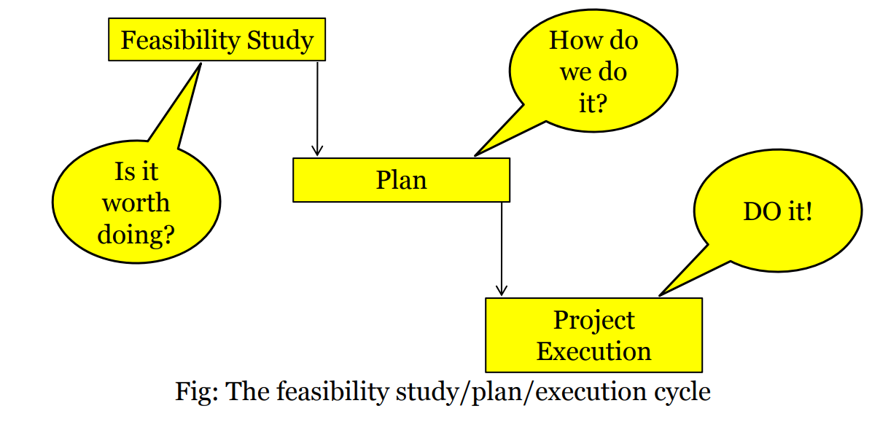
Software Project
A Software Project is the complete procedure of software development from requirement gathering to testing and maintenance, carried out according to the execution methodologies, in a specified period of time to achieve intended software product.
Notes:
Often you see something like ‘feasibility study’ being put as the first stage of development life cycle, and indeed it might be. However, the outcome of the feasibility study might be not to carry out the proposed project. Planning of the project should therefore take place after the feasibility study (or as a part of the feasibility study perhaps). Clearly the feasibility study itself might need a plan.
All plans are to some extent provisional and subject to change. The key point is that the evolving plan allows us to control the project.

Slide 18
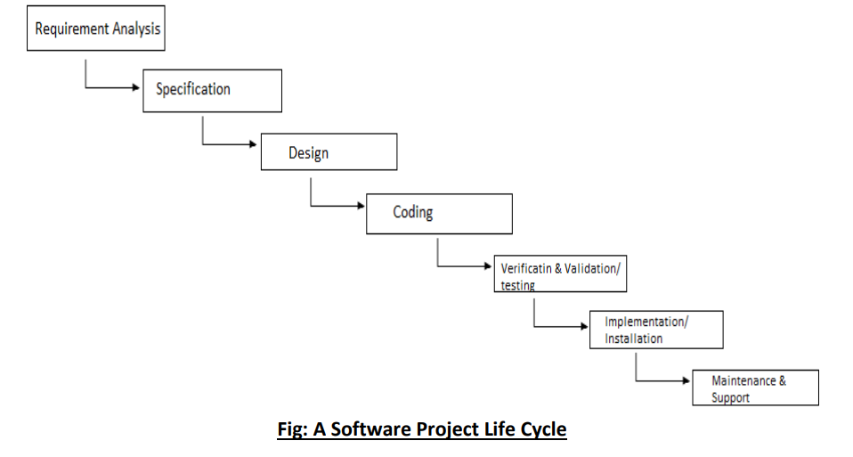
Software Project Lifecycle

Slide 19
Software Projects vs. Other Types
The major difference between a software project and a construction project is that with a construction project the customer knows what they want: a house, a factory, a bridge. Or even if it something that has never been built before like a stealth aircraft at least they know the features that they want and how to describe those features.
Software is different. The customer doesn't know exactly what they want the software to achieve, what is possible or the full set of features that they need. They need to be shown. It is actually seeing the software in action that crystallizes in their mind what they want it to achieve.
It is easier for the customer to conceptualize physical products than software ones. And managing projects for a hardware product requires much less ongoing iteration than software projects.

Slide 20
Software Projects vs. Other Types
The product of software project have certain characteristics which make them different
Invisibility: When a physical artifact such a bridge or road is being constructed the progress being made can actually be seen. With software, progress is not immediately visible.
Complexity: Per dollar, pound or euro spent, software products contain more complexity than other engineered artifacts.
Conformity: The traditional engineer is usually working with physical systems and physical materials like cement and steel. These systems can have some complexity but are governed by physical laws that are consistent. Software developers have to confirm to the requirements of human clients that certainly keeps on fluctuating.
Flexibility: The ease with which software can be changed is usually seen as one of its strengths. Software systems are subject to a high degree of change.

Slide 21
Examples of projects include but are not limited to:
Constructing a building.
Developing a new pharmaceutical compound for market,
Expanding a tour guide service,
Merging two organizations,
Improving a business process within an organization,
Acquiring and installing a new computer hardware system for use in an organization,
Exploring for oil in a region,
Modifying a computer software program used in an organization,
Conducting research to develop a new manufacturing process

Slide 22
Examples of Software Projects
A small software development team adds a new feature to an internal software application for the finance department
A company develops a new system to increase sales force productivity and customer relationship management
A government group develops a system to track Covid immunizations
Social Media
e-Commerce

Slide 23
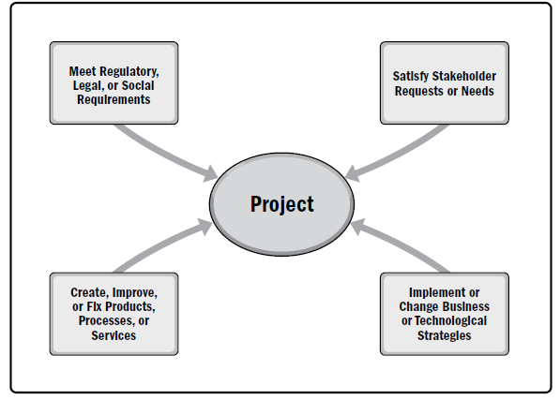
Project Initiation Context- what factors make the organization/someone start a project
Organizational leaders initiate projects in response to factors acting upon their organizations.
four fundamental categories for these factors, which illustrate the context of a project initiation

Slide 24
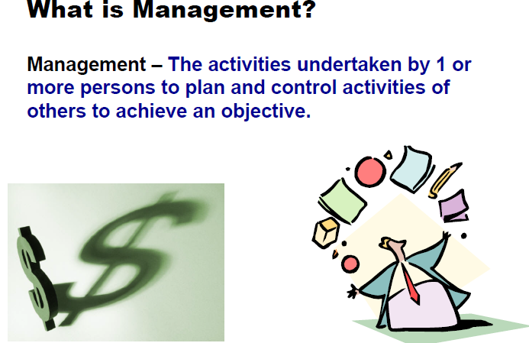

Slide 25
What is Management
It has been suggested that management involves the following activities:
Planning – Deciding what is to be done
Organization – making arrangements
Staffing – selecting the right people for the job
Directing – giving instructions
Monitoring – checking on progress
Controlling – taking action to remedy hold-ups
Innovating – coming up with new solutions
Representing – liaising with clients, users, developer, suppliers and other stakeholders

Slide 26
Management Control
Management, in general, involves setting objectives for a system and then monitoring the performance of the system.
This will involve the local managers in data collection.
data processing will be needed to transform this raw data into useful information

Slide 27
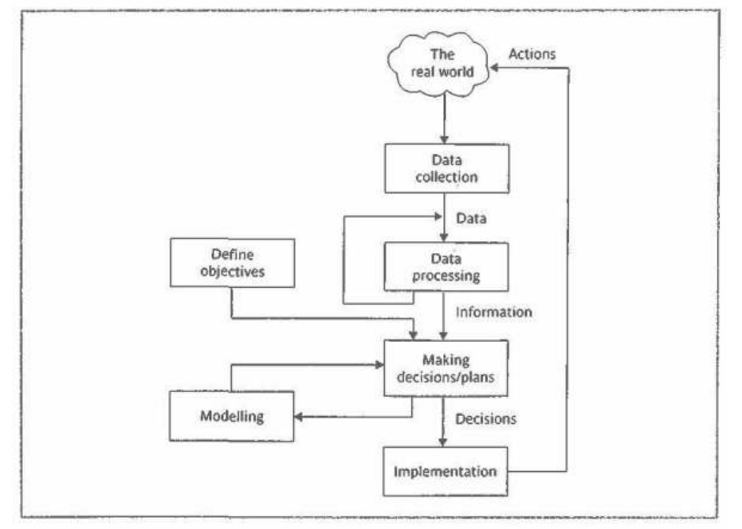
Management Control
Fig: Project Control Cycle

Slide 28
Project Management
Project management is the application of knowledge, skills, tools, and techniques to project activities → to meet the project requirements.
accomplished through the appropriate application and integration of the project management processes identified for the project.
Project management enables organizations to execute projects effectively and efficiently.

Slide 29
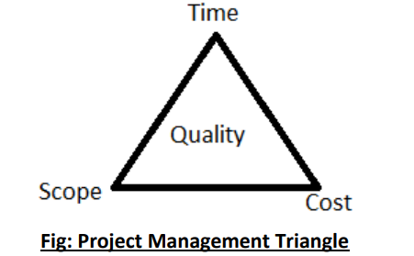
Project Management
Projects must be delivered on time.
Projects must be delivered within the cost that was estimated for the project initially.
Projects must satisfy the scope of the work agreed upon before starting the project.
Deliverables of the project must meet customer’s quality requirements

Slide 30
Software Project Management
Software project management is the art and science of planning and leading software
It is the process of managing, allocating and timing resources to develop computer software that meets requirements.
In Software Project Management the end users and developers need to know the length, duration and cost of the project.
It is sub-discipline of project management in which software projects are planned, implemented , monitored and controlled

Slide 31
Software Project Management Tasks
Problem Identification
Problem Definition
Project Planning
Project Organization
Resource Allocation
Project Scheduling
Tracking , Reporting and Controlling
Project Termination

Slide 32
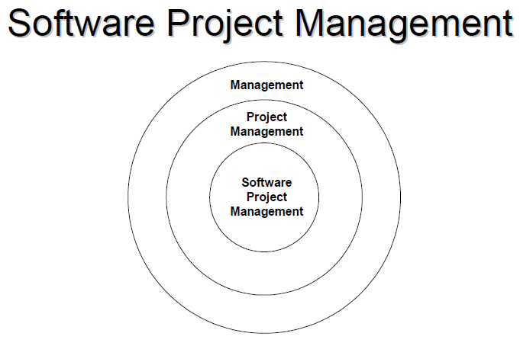

Slide 33
Project Success and Failure
We can distinguish between project objectives and business objectives. The project objectives are the targets that the project team is expected to achieve.
In the case of software projects, they can usually be summarized as delivering:
The agreed functionality
To the required level of quality
On time
Within budget
We have seen that in business terms it can generally be said that a project is a success if the value of benefits exceeds the costs.
Customer Relationships can also be built over a number of projects.

Slide 34
Problems with Software Projects
Poor estimates and plans
Lack of quality and standards
Lack of technique to make progress visible
Lack of knowledge of work (Domain)
Lack of documentation
Necessary hardware not deployed in time
Communication gap
Lack of motivation, commitment
Changing software environment
Training

Slide 35
Why Projects Fail
An unrealistic Deadlines is established
Changing Customer Requirements
An honest underestimate of effort
Predictable and/ or unpredictable risks
Miscommunication among project staff
Failure in Project Management practice

Slide 36
Avoiding Project Failure
Project Managers and Software Engineers must:-
Heed a set of common warning signs
Understand the Critical Success Factor (CFS) that lead to good Project Management
Develop a common sense approach for Planning, Monitoring and controlling a Project.
Management characteristics key to successful projects
Think yourself, list them
Then discuss with your friend
List them and give reason why you think they are important for project success?

Slide 37
Effective project management helps individuals, groups, and public and private organizations to:
Meet business objectives;
Satisfy stakeholder expectations;
Be more predictable;
Increase chances of success;
Deliver the right products at the right time;
Resolve problems and issues;
Respond to risks in a timely manner;
Optimize the use of organizational resources;
Identify, recover, or terminate failing projects;
Manage constraints (e.g., scope, quality, schedule, costs, resources);
Balance the influence of constraints on the project (e.g., increased scope may increase cost or schedule); and
Manage change in a better manner

Slide 38
Poorly managed projects or the absence of project management may result in:
Missed deadlines,
Cost overruns,
Poor quality,
Rework,
Uncontrolled expansion of the project,
Loss of reputation for the organization,
Unsatisfied stakeholders, and
Failure in achieving the objectives for which the project was undertaken.

Slide 39
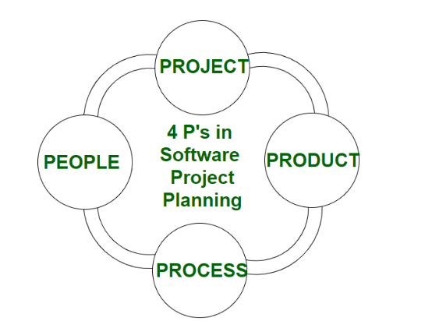
4 Ps of Software Project Management
Without them, the planning and execution phases of your project are very vulnerable to threats and roadblocks. To be more exact, it will be much more difficult for the team to achieve the project’s objectives.

Slide 40
People
the most important factor in success of software project.
Companies That sensibly manage their investment in people will prosper in the long run .
Cultivation of motivated and highly skilled software people has always been important for software organizations.
The people-factor is so important that has developed People Management Capability Maturity Model (PM-CMM).

Slide 41
PM-CMM
Developed by the Software Engineering Institute (SEI)
In simple words - to enhance the peoples capabilities through personnel development
Organizations that achieve high levels of maturity in PM-CMM have a higher likelihood of implementing effective software engineering practices
Key Practice Areas of PM-CMM
Recruiting
Selection
Performance Management
Training
Compensation
Career development
Organization and work design
Team/culture development

Slide 42
People Involved in SPM
Stakeholders are all the people involved in the project and they can be categorized as
Senior Managers: they define business issues that often have significant influence on business
Project (technical) managers: they must plan, motivate, organize and control the practitioners who do software work
Practitioners(IT Professionals, System Analysts, Team Leader): They deliver the technical skills necessary to engineer a product or application
Customers: They specify the requirements for the software to be engineered
End Users: They interact with the software after it is released for production use

Slide 43
Product
The product and the problem it is intended to solve must be examined at very beginning of the software project.
The scope of product must be established and bounded.
Bounded scope means establishing quantitative data like no. of simultaneous users, max. allowable response time. etc.
Constraints and limitations
The product doesn’t necessarily refer to a physical product. It is simply whatever represents the goal of the project.
For example, The development of a marketing strategy or campaign, or the realization of a new business division.
The resources, materials, quality, and everything else that defines the development of the project belong to the P of product.
Having a profound understanding of all the elements related to the product will help the project manager to define and control the deliverables throughout the project life cycle.

Slide 44
Process
Methodology the team will follow in order to produce the product
Product is what they will deliver, the process focuses on how they will deliver it.
This involves the exact tasks and activities that need to be completed, as well as putting a specific project management methodology in place.
A way to optimize and accelerate the process is to implement project management software.
One of the major benefits is always having a visual representation of how the process is outlined, and how it’s progressing.

Slide 45
Project
In this all of the emphasis on the importance of the project manager.
The project manager coordinates and controls the whole project through its life cycle, maintaining an overview at all times
Closely monitoring everything, the project manager makes sure that all team members have the data and resources they need to keep the project moving forward. They guide the team in other ways too, by keeping them motivated and holding them accountable.
Every little update or activity is overseen by the project manager, who deals with obstacles and keeps track of the budget and deliverables every step of the way.
checking on cost and budget, and making sure that the project stays on track with the given deadlines
Ultimately, the P for project can be defined as the structure or framework that is governed by the project manager in order to achieve the project’s objectives.

Slide 46
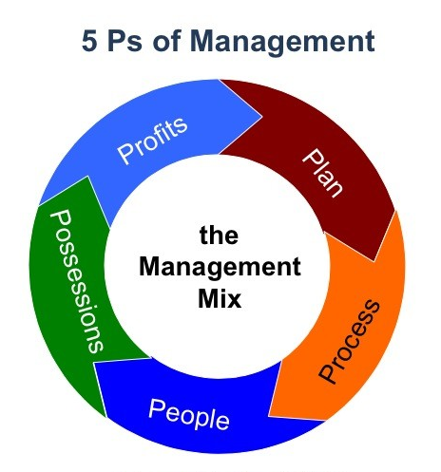
5 Ps of Management
Management is not about functions, but rather it is about the process of achieving organizational goals and creating value.
Globally competition is based on knowledge and the environment is changing rapidly.
Employees, suppliers, and shareholders have more knowledge and information than ever before, and there is, therefore, a need for a framework which enables managers to make decisions which lead to value creation.
The 5 P’s of management provide such a framework which are:
Plan
Process
People
Possessions
Profits
Notes:
4p’s
1. People
2. Product
3. Process
4. Project

Slide 47
5 Ps of Management
Plan:
The managers do not have the opportunity of making decisions under a background of certainty.
Planning involves setting clear and realistic goals, organizing business activity based on the revenues forecast, formulating strategies, preparing budgets, and implementing strategies, and evaluation and control systems.
Process:
includes both business process and operational process.
The business process is based on the business model of the firm. The business process guides the firm in generating revenues, managing costs, and generating profits.
An operational process consists of multiple inputs, outputs, and processes that result in an organizational output (product or service). In the operational process, inputs arise from all the basic business functions, including marketing, finance, operations management, human resources, and technology as required. Managers select the appropriate inputs and process modules necessary for the

Slide 48
5 Ps of Management
People:
include employees, suppliers, customers, and shareholders.
Possessions:
include assets and capital.
Organization capital includes human capital, intellectual capital, economic capital, and marketing capital.
Profits:
Managers adopt management processes which have the potential of generating long-term profits.
Managers evaluate organizational performance with both qualitative and quantitative measures.

Slide 49
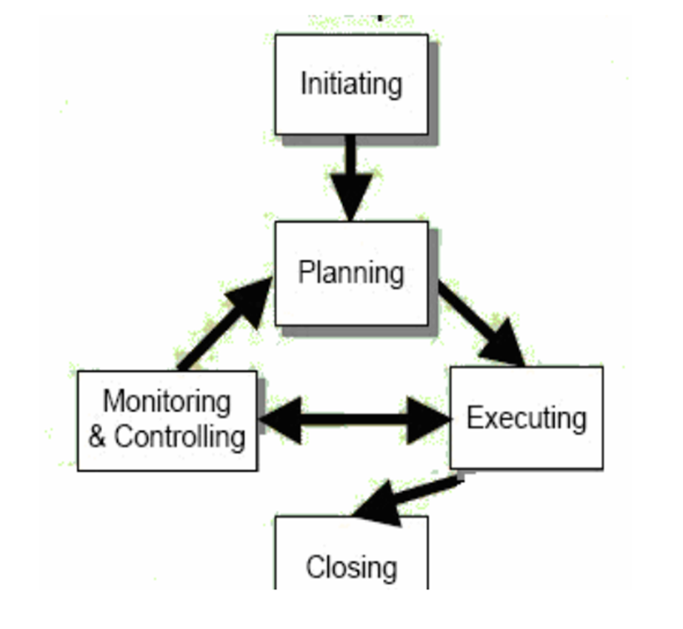
SPM Process
PM Lifecycle- Every Project requires a series of processes to complete its objective.
PMBOK breaks the process of managing a project into 5 stages:
Project Initiation
Project Planning
Executing
Monitoring and Control
Closing
Notes:
Project Management Body of Knowledge is PMI's flagship publication and is a fundamental resource for effective project

Slide 50
1. Project Initiation
During this phase, the project is conceptualized, and feasibility is determined. some activities performed during this process include:
defining the project goal;
defining the project scope;
identifying the project manager and the key stakeholders;
identifying potential risks,
and producing an estimated budget and timeline.
Notes:
Project Management Body of Knowledge is PMI's flagship publication and is a fundamental resource for effective project

Slide 51
2. Project Planning
The project manager will create a blueprint to guide the entire project from initiation through completion.
This blueprint will map out:
the project’s scope
resources required to create the deliverables
estimated time and financial commitments
communication strategy to ensure stakeholders are kept up to date and involved
execution plan
and proposal for ongoing maintenance
***If the project has not yet been approved, this blueprint will serve as a critical part of the pitch.
!!!! Documentation important

Slide 52
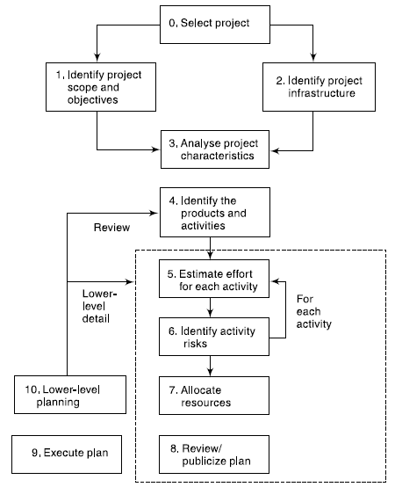
2. Project Planning

Slide 53
3. Executing
During this phase, the project manager will conduct the procurement required for the project and staff the team.
Execution of the project objectives requires effective management of the team members on the ground.
PMs are responsible for delegating and overseeing the work on the project while maintaining good relationships with all team members and keeping the entire project on time and budget.
The PM must, therefore, be highly organized and an exceptional leader. That’s because they’ll need to address team concerns and issues that arise along the way, requiring frequent and open communication with all team members and stakeholders.

Slide 54
4. Monitoring and control
Project managers will closely measure the project's progress to ensure it is developing properly.
Documentation such as data collection and verbal and written status reports may be used.
Monitoring and controlling are closely related to project planning. While planning determines what is to be done, monitoring and controlling establish how well it has been done
Monitoring will detect any necessary corrective action or change in the project to keep the project on track.

Slide 55
5.Closing
The closing process group occurs once the project deliverables have been produced and the stakeholders validate and approve them.
During this phase, the project manager will close contracts with suppliers, external vendors, consultants, and other third-party providers.
All documentation will be archived, and a final project report will be produced.
Further, the final part of the project plan — the plan for troubleshooting and maintenance — will kick into place.

Slide 56
The Triple Constraint Of Project (Project Management Triangle/ Iron Triangle/ Quality Triangle)
A project is limited in different ways by its scope, time, and cost goals. These limitations are as the triple constraint.
To create a successful project, a project manager must consider scope, time, and cost and balance these three often-competing goals. A Project Manager must consider the following:
Quality
Time
Cost
Scope/ Requirement
Fig: Project Management Triangle/ Iron Triangle/ Quality Triangle

Slide 57
1. Project Triple Constraints →Scope:
What work will be done as part of the project?
What unique product, service, or result does the customer or sponsor expect from the project?
How will the scope be verified?

Slide 58
2. Project Triple Constraints →Time:
How long should it take to complete the project?
What is the project schedule?
How will the team track actual schedule performance?
Who can approve changes to the schedule?

Slide 59
3. Project Triple Constraints →Cost
What should it cost to complete the project?
What is the project’s budget?
How will costs be tracked?
Who can authorize changes to the budget?

Slide 60
On Managing Triple Constraints
Managing the triple constraint involves making trade-offs between scope, time, and cost goals for a project.
For example, you might need to increase the budget for a project to meet scope and time goals.
Alternatively, you might have to reduce the scope of a project to meet time and cost goals.
!!! Vvy imp →Experienced project managers know that you must decide which aspect of the triple constraint is most important.
If time is most important, you must often change the initial scope and/or cost goals to meet the schedule.
If scope goals are most important, you may need to adjust time and/or cost goals.

Slide 61
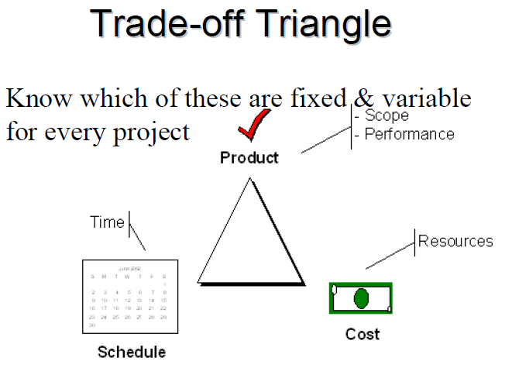

Slide 62
What if triple constraints are met but customers aren’t satisfied??
Quality is often a key factor in projects, as is customer or sponsor satisfaction.
Some people, in fact, refer to the quadruple constraint of project management, which includes quality as well as scope, time, and cost.
Others believe that quality considerations, including customer satisfaction, must be inherent in setting the scope, time, and cost goals of a project.
A project team may meet scope, time, and cost goals but fail to meet quality standards or satisfy their sponsor, if they have not adequately addressed these concerns.
How can you avoid the problems that occur when you meet scope, time, and cost goals, but lose sight of quality or customer satisfaction? → The answer is
good project management, which includes more than meeting the triple constraint.

Slide 63
Project Manager Duties
Developing a software project plan
Manage deliverables according to the software project plan
Recruiting software project staff
Leading and managing the software project team
Determining the methodology used on the project
Establishing a project schedule and determine each phase
Assigning tasks to project team members
Providing regular updates to senior management

Slide 64
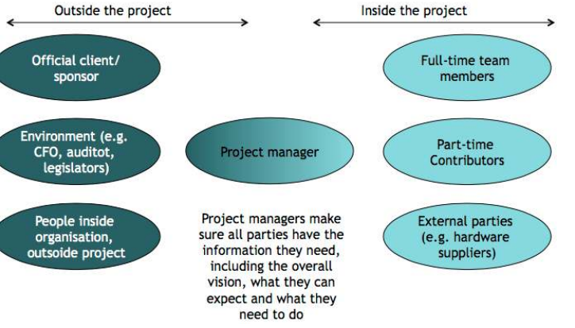
Project Manager Duties

Slide 65
Characteristics of a effective project managers
Competent practitioners often make poor team leaders as they lack the right mix of skills
MOI Model of leadership (Jerry Weinberg)
Motivation
Encourage technical people (by push or pull) to produce
Organization
Apply, improve processes efficiently
Ideas or Innovation
Make people feel creative
Be Creative

Slide 66
Characteristics of a effective project managers
Problem Solving
Diagnostic
Skill to solve
Ability to design solution
Managerial Identity
Control the project
Achievement
Reward Initiative
Encourage Controlled risk taking
Influence and team building
Influence the team
Read people's mind and respond according to their needs
Be controlled in stress situations

Slide 67
Characteristics of a effective project managers
Project Managers should set objectives SMART
Specific: clearly defined not vague
Measurable: project achievement can be measured, compared and controlled
Acceptable: by all the members of the team, agreed goal raise the sense and commitment
Realistic: considering the given possible resources, experience, knowledge and time available
Time frame: if there is no time to complete the process it will never be completed

Slide 68
SPM must be experts in
Risk management
And contingency planning to ensure progress in the face of roadblocks or changes.

Slide 69
Contingency Plan
a plan for a “what if” scenario that could ruin your project or business.
a contingency is all about expecting the unexpected and preparing to deal with worst-case scenarios ahead of time.
The vast majority of failed projects and bankrupt companies had a plan and followed it.
So why do these projects and companies end up failing?
Due to uncertain nature of the real world unexpected things happen that companies don’t plan for, and many fail to adapt in time.

Slide 70
Contingency Plan
To back up all website data in case a website gets hacked.
If this scenario happens, it’s easy to restore the data after regaining access and changing passwords.
If you haven’t done contingency Plan then or Not prepared? →The team might have to recreate the entire website from memory. That’s a significant expense and can mean several extra days (or weeks!) of downtime.
A contingency plan deals with eventualities like the above. But, it’s about managing and lowering risk and setting up for speedy disaster recovery.
A few years ago, people would have brushed off companies that prepared for global pandemics and government lockdowns
But it all paid off for them in this time of crisis.
Compare the case with Sarathi app in kathmandu, it failed why????

Slide 71
Project Vs Program Vs Portfolio
A project is a temporary endeavor undertaken by a company or organization (such as the creation of a new product, service, or result)
A program is a group of projects that are similar or related to one another, and which are often managed and coordinated as a group instead of independently
A portfolio is a group of different programs and/or projects within the same organization, which may be related or unrelated to one another

Slide 72
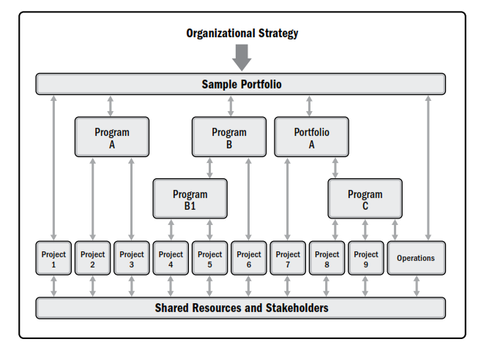
Project Vs Program Vs Portfolio Management
Notes:
A program is a group of related projects, subsidiary programs, and program activities that are managed in a coordinated manner to obtain benefits not available from managing them individually.

Slide 73
Project Manager Vs Program Manager Vs Portfolio Manager
Project managers might provide updates on how current projects are doing or how successful finished projects were to program managers.
Program managers may oversee a team of project managers, providing guidance and instructions on how to best set up or coordinate a project.
Portfolio managers may meet with program managers and project managers to align projects with large-scale objectives and provide key performance metrics

Slide 74
Characteristics of Program Manager
Program management is not simply managing multiple projects—it’s a bit more strategic than that.
The program manager also doesn’t micromanage those projects; he or she is helping ensure that the right work is moving between the right projects at the right points in time.
The program manager focuses, throughout the program, on the business benefits, starting very early at its inception by looking at what benefits can be realized and then making that happen.
The role of the program manager is to ensure that the benefits intended are met by validating that the correct projects are included in the program. Any project not providing value to the benefits is then realigned or removed from the program.
The program manager is responsible for overseeing the dependencies between projects and creating program-level plans to accomplish this.
The program manager is focused on benefits realization—rather, knowing the benefits that can be accomplished from this collection of projects and focusing on achieving them. The program manager is also working to manage organizational change and ensure that the benefits are not only transitioned to operations, but that processes are in place to sustain these benefits.
Since the role of program management is to ensure that projects are aligned to the business strategy, as the strategy changes, the program manager also needs to communicate with the project teams so that they are aware of the changes and what needs to be done about them.

Slide 75
Characteristics of Portfolio Manager
Portfolio management is the centralized management of one or more portfolios to achieve an organization’s strategic objectives.
Within organizations, the reality is often that resources are limited, whether it’s cost, people, space, or equipment. Based on the organization’s strategy, there are several projects and programs that could be done; it just needs to be decided which are the right ones and in what order they should be completed.
It’s critical to look not only at programs and projects at the individual level, but also holistically to know how these align with the organization’s overarching goals.
At the same time, it’s important to consider a level of balance in the portfolio. The organization “needs to keep the lights on,” while also developing new opportunities. Some risk needs to be taken, but the portfolio should not be so risky that everything could be lost within a period of time.
Beyond prioritizing and selecting projects and programs, portfolio management is balancing the portfolio so that the right projects and programs are selected and implemented. Monitoring and controlling is key to the process, since portfolio composition is not a one-time decision. Evaluations should be conducted in some regular cadence. It may be decided that a project’s priority becomes lower and others move into its place. A project could be temporarily moved out of the portfolio or permanently moved out of what that portfolio entails.
This is done to ensure projects align with an organization’s strategies, goals, and objectives. It may also be the case that, as we get into performing a project or program, we find it no longer aligns, causing a reprioritization of all projects and programs in the portfolio.

Slide 76
W5HH Principle
Excellent planning outline for project managers and software team
Applicable to all sizes of software projects
It is an approach to address
project objectives
Milestones & schedule
Responsibilities
Management & technical approaches
Required resources

Slide 77
W5HH Principle
Why is the system being develop?
Answer to this questions help assess validity of business reason for the software work.
It answers if the business purpose justifies the expenditure of people, time and money
What will be done?
Answer to this question establishes the task set required for project
When will it be done?
Answer to this question helps the team establish a project schedule by identifying when tasks have to be conducted and when milestones are to be reached

Slide 78
W5HH Principle
Who is responsible for a function ?
Answer to this question establishes roles and responsibility of each team member
Where are they organizationally located ?
Answer to this question indicates that all roles and responsibilities are not limited to the software team itself, the customers, users and stakeholders also have responsibilities.
How will be job done technically and managerially ?
Once product scope is establishes, a technical and management strategy must be defined for it.
How much of each resource is needed ?
Answer to this question is derived by developing estimates based on answers to earlier questions.

Slide 79
Software Project Failure Case
Software Failure → A failure that occurs when the user perceives that the software has ceased to deliver the expected result with respect to the specification input values. The user may need to identify the severity of the levels of failures such as catastrophic, critical, major or minor, depending on their impact on the system
Software Related Failures :
Programming errors
Error such as incorrect storage size can be catastrophic
Passive failures
Software, node and link failures can cut off sub-system
Active failures
Faulty software can interfere with other sub-system
Byzantine failures
“Byzantine generals problem” developed to describe a situation in which, in order to avoid catastrophic failure of the system, the system's actors must agree on a concerted strategy, but some of these actors are unreliable
Malicious agents can actively interfere with system operation

Slide 80
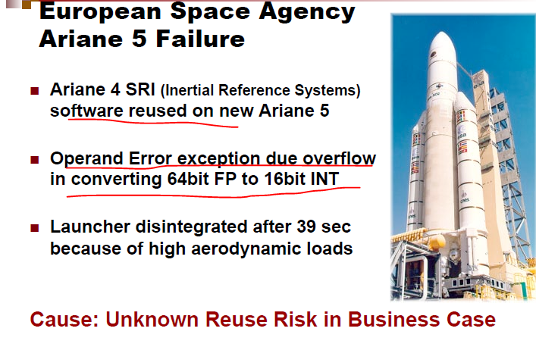

Slide 81
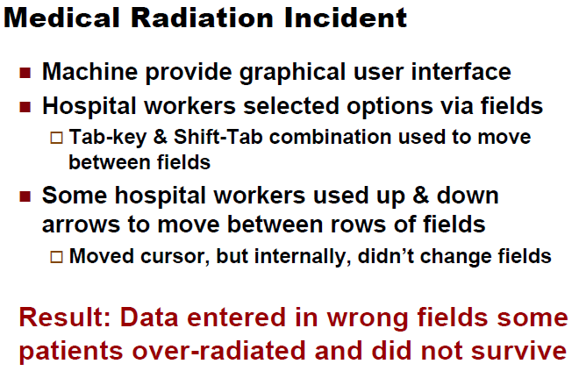

Slide 82
Denver Airport Automated system for luggage travel and transfer-Project Failure Case
Denver airport started at 1990 and opened at 1995
Goal –replace manual labor with fully automated baggage system
System at a glance:
Covering a land area of 140 Km2
88 airport gates in 3 concourses
17 miles of track and 5 miles of conveyor belts
3,100 standard carts + 450 oversized carts
14 million feet of wiring
Network of more than 100 PC’s to control flow of carts
5,000 electric motors
2,700 photo cells, 400 radio receivers and 59 laser arrays

Slide 83
Denver Airport Automated system for luggage travel and transfer-Project Failure Case
At the end of the project instead of fully functioning automated system we got into a serious problem:
16 months past the deadline
$560 million over budget
Performed just a fraction of automation
Closure on 2005

Slide 84
Reasons For Its Failure
Lack Proper Communication
Adding extra project features and hence added more to complexity while the project was already complex
Poor Project Definitions – Project goals, objectives and limitations

Slide 85
Reasons For Its Failure (contd..)
Stakeholder Politics, Unrealistic and unarticulated Project goals , Project complexity, unrealistic deadlines
The city of Denver did a feasibility study which stated the project was to complex but the city decided to carry out anyway
A similar project was built in Munich taking 2 complete years followed by 6 months 24/7 testing prior to actual lunch but this project was due to open in little over two years →finishing a complicated project in shorter time
One of the project bidder estimated the project of 4 years but the concern was ignored with a deadline of 2 years

Slide 86
Reasons For Its Failure (contd..)
Poor Communication and elimination of key stake holder
Even though software team and the Airport project management team were involved, the key stakeholders i.e. airlines official affected by the outcome weren’t bought into discussion during project planning phase
Effect→ the airlines staffs (key stakeholders) were asked at last, for their opinions and they required major changes from the project team → adding ski requirement racks, different way of handling oversized luggage etc

Slide 87
Reasons For Its Failure (contd..)
No early communication between key stakeholders
Once the airlines were finally asked for their opinions, they required major changes from the project team: adding ski equipment racks, different handling for oversized luggage, and separate maintenance tracks for broken carts. The requests required major redesign on portions of the project — some of which had already been "completed." But these requests were not optional features for the airlines, and the project team was forced to redo their work.
By waiting to approach stakeholders, the project team wasted time and money. Had they approached the airlines right away, they would have been able to incorporate these requests into early project plans. They would have shaved off months of extra labor if they didn't have to redo completed work; not overshooting their deadline by 16 months would have saved them a good chunk of the extra $560 million spent.
It is essential that we include stakeholders from Day 1 to avoid wasting time and money. Don't make the same mistake of waiting until halfway through a project to collect vital requirements.

Slide 88
Reasons For Its Failure (contd..)
all-at-once "Big Bang" rollout
all-at-once "Big Bang" rollout to all three concourses, as opposed to slower, incremental rollout.
The team should have tested the new automated system in sections →to make sure it would work before implementing it throughout the rest of the airport.
The best way to get big results is to first ensure you can create a successful minimal viable product. Once your MVP works well, repeat the process on a larger playing ground, slowly scaling efforts until you reach the end goal

Slide 89
Summary Denver Airport Luggage Automation system Failure
Contributing factors :
Underestimation of complexity.
Complex architecture.
Changes in requirements.
Underestimation of schedule and budget.
Dismissal of advice from experts
Failure to build in backup or recovery process to handle situations

Slide 90
Lesson Learned
Minimum Viable Product. It is the smallest number of features that need to be developed in order to push your product or service to your early adopters.
Focus all your time, energy, and money on developing just your MVP, and nothing else. Yes, that means your product or service won't be completely evolved to fulfill all your dreams or the product roadmap, but it will be functional. With it, you can start learning and earning — learning about customers' needs as they interact with your MVP, and earning money to expand upon the rest of your ideas.
If your resources are going into developing an extra feature beyond the MVP ("It's just a little thing, it won't take much!") you are wasting time, manpower, and money. And you could be setting yourself up as the next failed startup. Every second and every dollar counts.
You'll have time to expand upon the rest of your ideas later, but for now, speed is essential. Focus on getting something out there so that you can move on to the next step: improving your product through validated learning.

Slide 91
Lesson Learned
!!! Next time you're working on a project, remember these three lessons and avoid facing the same fate as Denver International Airport:
Watch for red flags, and heed the warnings of experts.
Involve all project stakeholders from Day 1.
Take small steps to successfully reach the end goal.
Good luck on your next projects and next flights! ☺ ☺

Slide 92
Some Examples of Software Failure
Case #1: St. Mary’s Mercy Hospital
Imagine waking up one day, checking your mailbox an receiving a letter from your hospital saying you died. Well, that is precisely what happened to 8500 people who received treatment between Oct 25 and Dec 11 at St. Mary’s Mercy Hospital. So what happened? It turns out the hospital had recently upgraded its patient-management software system. However, a mapping error in the software resulted in the system assigning a code of 20 (which means “expired”) instead of 01 which meant the patient had been discharged. But that is not all. The erroneous data was not only sent to the patients but also to insurance companies and the local Social Security Office. It is not clear how [2]

Slide 93
Some Examples of Software Failure
Case #2: National Health Service
I don’t know what is worse: Not taking your medicines at all or taking the wrong medication. Either way, at least 300,000 heart patients were given the wrong drug or advise as a result of a software fault. So, what happened? In the year 2016, it was discovered that the clinical computer system SystmOne had an error that since 2009 had been miscalculating patient’s risk of heart attack. As a result, many patients suffered heart attacks or strokes since they were told they were at low-risk, while other suffered from the side-effects of taking unnecessary medication [3].

Slide 94
Some Examples of Software Failure
Case #3: Air Traffic Control in LA Airport
The air traffic control has the important responsibility of informing aircraft pilots about relevant information regarding weather, routes, the distance between other airplanes, and more. Failing to communicate with aircraft pilots promptly could result in catastrophe. On September 14, 2004, at 5 P.M. air traffic control at the LA airport lost voice communication with approximately 400 airplanes being tracked in the southwestern United States and many planes were headed towards each other. So what happened? The primary voice communication system shut down unexpectedly. To top it off the backup system failed a few minutes after it was turned on. The cause of the error was that the communication system had an internal timer that ticks off in milliseconds. After it reached zero, it could not time itself so it would shut down. The outage affected 800 flights across the country [4].

Slide 95
Some Examples of Software Failure
Case #4: Toyota
In the mid-2000’s many Toyota drivers were reporting that their car was accelerating without them touching the pedal. After a series of accidents, which lead to investigations, investigators discovered that software errors were the cause of the unintended acceleration. In this case, there was a series of things wrong with the software installed in Toyota cars: Memory corruption, wrong memory handling, disabling safety systems, systems with single points of failure, and thousands of global variables. Toyota recalled millions of vehicles and Toyota’s stock price decreased 20% a month after the cause of the problem was discovered. This case demonstrates the consequences of not giving enough attention to good programming practices and testing as a result of wanting to launch the product.

Slide 96
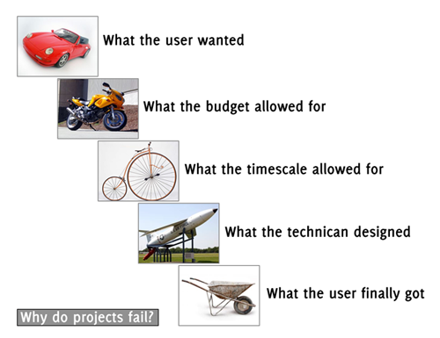
Why Do Project Fail

Slide 97
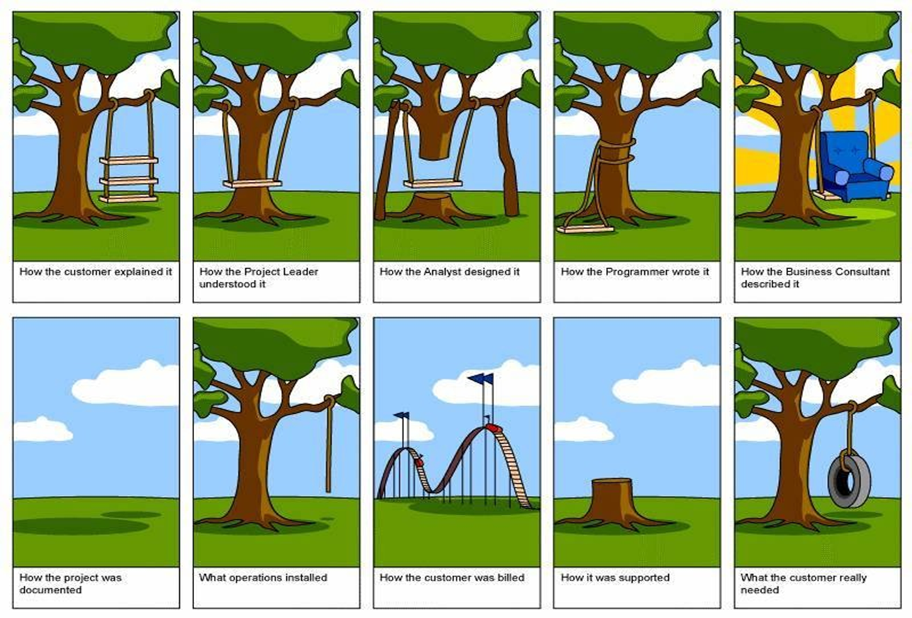

Why Do Project Fail

Slide 98
Questions ???
Why is there a new or renewed interest in the field of project management?
What is a project, and what are its main attributes? How is a project different from what most people do in their day-to-day jobs? What is the triple constraint?
What is project management? Briefly describe the project management framework, providing examples of stakeholders, knowledge areas, tools and techniques, and project success factors.
What are 3Ps of Project Management ? Briefly describe them.
Discuss the relationship between project, program, and portfolio Management and their contribution to enterprise success.
What are the roles of the project, program, and portfolio managers? What are suggested skills for project managers? What additional skills do program and portfolio managers need?

